Slide 1

18CSC207J – Advanced Programming Practice

Slide 2
Course Content
Unit 1
Structured Programming Paradigm
Procedural Programming Paradigm
Object Oriented Programming Paradigm
Unit 2
Event Driven Programming Paradigm
Declarative Programming Paradigm
Imperative Programming Paradigm
Unit 3
Parallel Programming Paradigm
Concurrent Programming paradigm
Functional Programming Paradigm
Unit 4
Logic Programming Paradigm
Dependent Type Programming Paradigm
Network Programming Paradigm
Unit 5
Symbolic Programming paradigm
Automata Programming Paradigm
GUI Programming paradigm

Slide 3
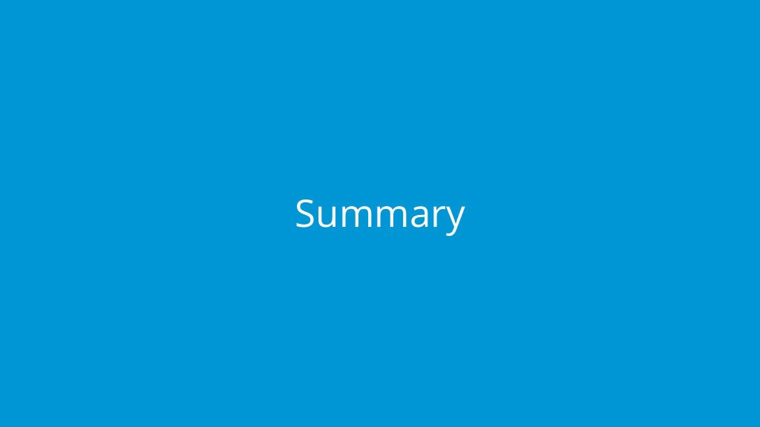
Introduction to Programming Paradigm

Slide 4
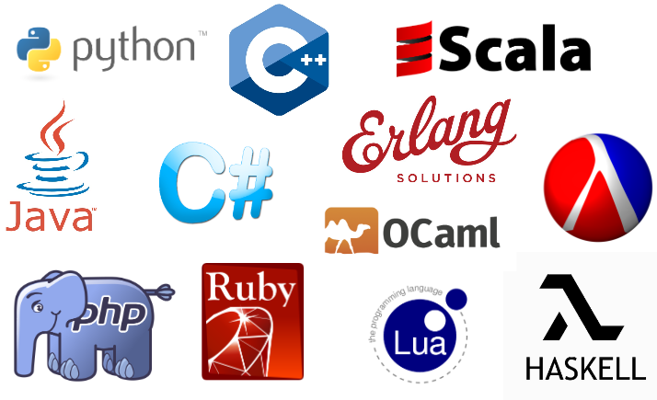
Introduction to Programming Paradigm
Hundreds of programming languages are in use...

Slide 5
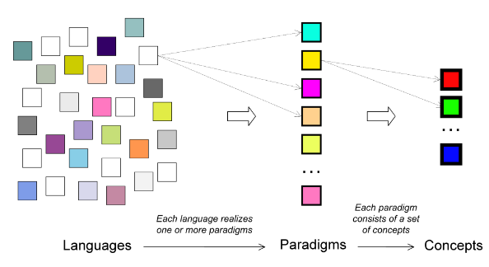
Introduction to Programming Paradigm
So many, how can we understand them all?
Key insight:
Languages are based on paradigms, and there are many fewer paradigms than languages
We can understand many languages by learning few paradigms

Slide 6
What is a Programming Paradigm?
A programming paradigm is an approach to programming a computer based on a coherent set of principles or a mathematical theory
A program is written to solve problems
Any realistic program needs to solve different kinds of problems
Each kind of problem needs its own paradigm
So we need multiple paradigms and we need to combine them in the same program

Slide 7
How can we study multiple paradigms? How can we combine paradigms in a program?
How can we study multiple paradigms without studying multiple languages (since most languages only support one, or sometimes two paradigms)?
Each language has its own syntax, its own semantics, its own system, and its own quirks
We could pick python language and structure our course around them
Each paradigm is a different way of thinking
How can we combine different ways of thinking in one program?
We can do it using the concept of a kernel language
Each paradigm has a simple core language, its kernel language, that contains its essential concepts
Every practical language, even if it’s complicated, can be translated easily into its kernel language
Even very different paradigms have kernel languages that have much in common; often there is only one concept difference
We start with a simple kernel language that underlies our first paradigm, functional programming
We then add concepts one by one to give the other paradigms

Slide 8
Introduction to Programming Languages
A programming language is an artificial language designed to communicate
instructions to a machine, e.g., computer
The earliest programming languages preceded the invention of the computer
e.g., used to direct the behavior of machines such as Jacquard looms and player pianos.
“Programming languages are the least usable, but most powerful human-computer interfaces ever invented”

Slide 9
Introduction to Programming Languages
Programming languages provide an abstraction from a computer’s instruction set architecture
Low-level programming languages provide little or no abstraction, e.g., machine code and assembly language
Difficult to use
Allows to program efficiently and with a low memory footprint
High-level programming languages isolate the execution semantics of a computer architecture from the specification of the program
Simplifies program development
Machine code
8B542408 83FA0077 06B80000 0000C383
C9010000 008D0419 83FA0376 078BD98B
B84AEBF1 5BC3
Assembly language
mov edx, [esp+8]
cmp edx, 0
ja @f
mov eax, 0
ret
High-level language
unsigned int fib(unsigned int n) {
if (n <= 0)
return 0;
else if (n <= 2)
return 1;
else
...
}

Slide 10
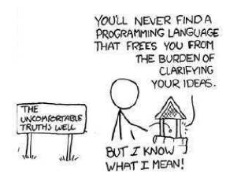
Introduction to Programming Languages
Programming languages can be categorized into programming paradigms
Meaning of the word ’paradigm’
“An example that serves as pattern or model”
“Paradigms emerge as the result of social processes in which people develop ideas and create principles and practices that embody those ideas”
Programming paradigms are the result of people’s ideas about how computer programs should be constructed
Patterns that serves as a “school of thoughts” for programming of computers
Once you have understood the general concepts of programming paradigms, it becomes easier to learn new programming languages

Slide 11
Basics of Programming Language
Elements of Programming Language
Programming languages have many similarities with natural languages
e.g., they conform to rules for syntax and semantics, there are many dialects, etc.
We are going to have a quick look at the following concepts
Compiled/Interpreted
Syntax
Semantics
Typing

Slide 12
Structured Programming Paradigm

Slide 13
1. Structured Programming Paradigm
Program is made as a single structure.
Code will execute the instruction by instruction one after the other.
It doesn’t support the possibility of jumping from one instruction to some other with the help of any statement like GOTO, etc.
The structured program consists of well structured and separated modules. But the entry and exit in a Structured program is a single-time event. It means that the program uses single-entry and single-exit elements.
Instructions in this approach will be executed in a serial and structured manner. The languages that support Structured programming approach are: C, C++, Java, C# ..etc
The structured program mainly consists of three types of elements:
Selection Statements
Sequence Statements
Iteration Statements

Slide 14
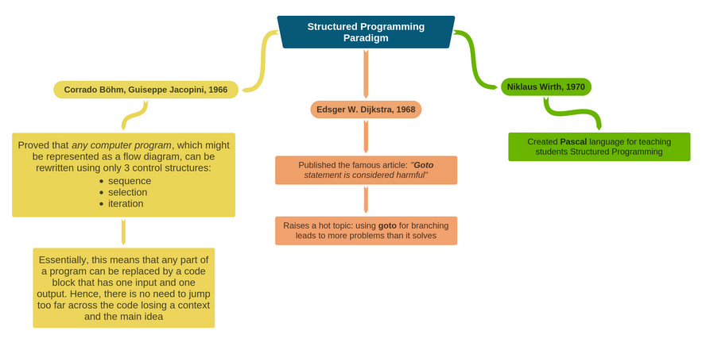
1. Structured Programming Paradigm

Slide 15
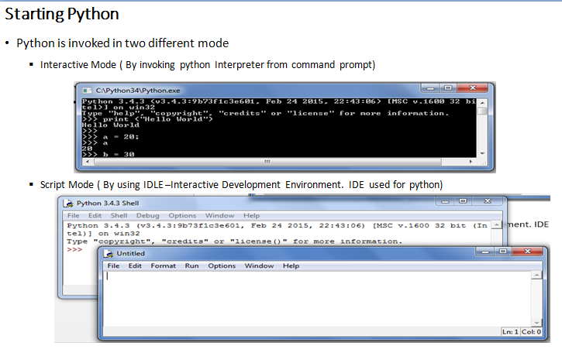
1. Structured Programming Paradigm

Slide 16
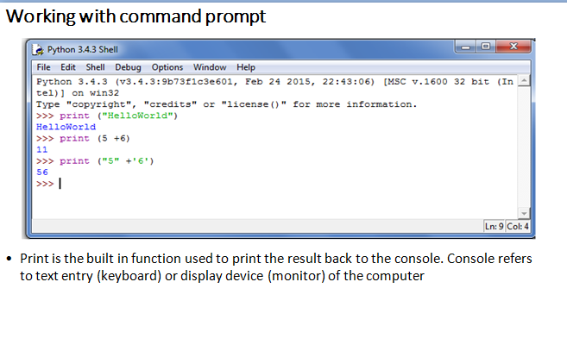
1. Structured Programming Paradigm

Slide 17
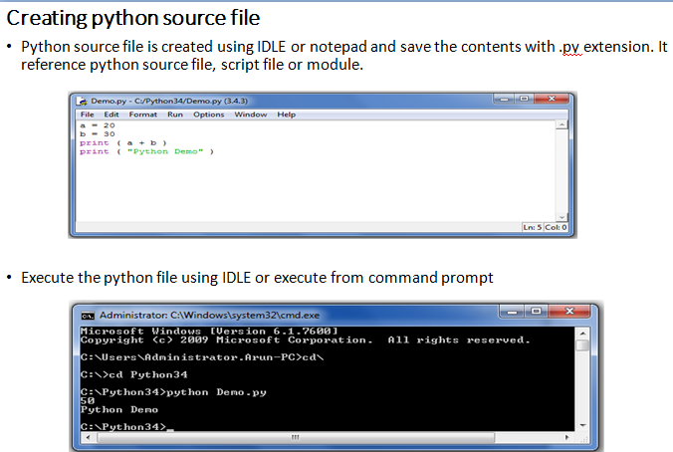
1. Structured Programming Paradigm

Slide 18
Selection Statement
If else
Syntax:
if test expression:
statement(s)
If else
Syntax:
if test expression:
Body of if
else:
Body of else
If elif else
Syntax:
if test expression:
Body of if
elif test expression:
Body of elif
else:
Body of else
Example:
num = float(input("Enter a number: "))
if num > 0:
print("Positive number")
print("This is always printed")
Example:
num = float(input("Enter a number: "))
if num >= 0:
print("Positive or Zero")
else:
print("Negative number")
Example:
num = float(input("Enter a number: "))
if num > 0:
print("Positive number")
elif num == 0:
print("Zero")
else:
print("Negative number")

Slide 19
1. Structured Programming Paradigm
Conditional
A conditional expression evaluates an expression based on a condition.
Conditional expression is expressed using if and else combined with expression
Syntax:
expression if Boolean-expression else expression
Example:
Biggest of two numbers
num1 = 23
num2 = 15
big = num1 if num1 > num2 else num2
print ( “ the biggest number is “ , big )
Even or odd
print ( “ num is even “ if num % 2 == 0 else “ num is odd “)

Slide 20
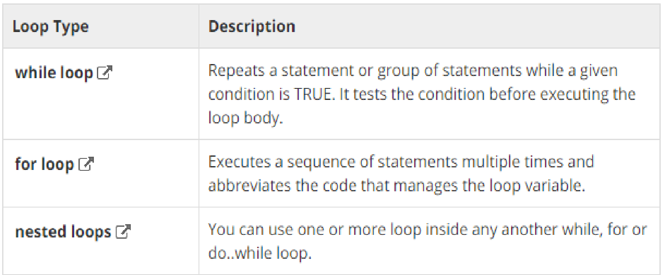
1. Structured Programming Paradigm
Looping

Slide 21
1. Structured Programming Paradigm
while loop
Syntax:
while expression:
statement(s)
Example:
count = 0
while (count < 9):
print 'The count is:', count
count = count + 1
print "Good bye!”
For Loop
Syntax:
for iterating_var in sequence:
statements(s)
Example:
for letter in 'Python': # First Example
print 'Current Letter :', letter
fruits = ['banana', 'apple', 'mango']
for index in range(len(fruits)):
print 'Current fruit :', fruits[index]
print "Good bye!“
Else with looping:
Example
for num in range(10,20): #to iterate between 10 to 20
for i in range(2,num): #to iterate on the factors of the number
if num%i == 0: #to determine the first factor
j=num/i #to calculate the second factor
print '%d equals %d * %d' % (num,i,j)
break #to move to the next number, the #first FOR
else: # else part of the loop
print num, 'is a prime number‘

Slide 22
Procedure Programming Paradigm

Slide 23
Introduction
High level languages such as COBOL, FORTRAN and C, is commonly known as procedure oriented programming(POP). In the procedure oriented programming, program is divided into sub programs or modules and then assembled to form a complete program. These modules are called functions.
The problem is viewed as a sequence of things to be done.
The primary focus is on functions.
Procedure-oriented programming basically consists of writing a list of instructions for the computer to follow and organizing these instructions into groups known as functions.
In a multi-function program, many important data items are placed as global so that they may be accessed by all functions. Each function may have its own local data. If a function made any changes to global data, these changes will reflect in other functions. Global data are more unsafe to an accidental change by a function. In a large program it is very difficult to identify what data is used by which function.
This approach does not model real world problems. This is because functions are action-oriented and do not really correspond to the elements of the problem.

Slide 24
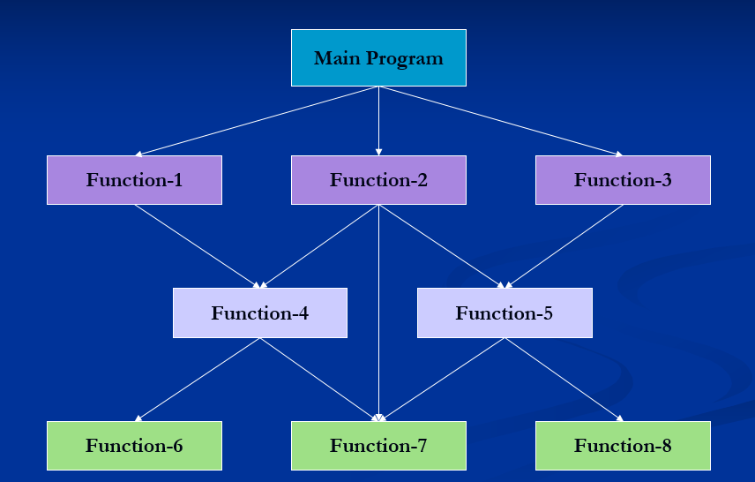
Typical structure of procedure-oriented program

Slide 25
Characteristics of Procedure-Oriented Programming
Emphasis is on doing things.
Large programs are divided into smaller programs known as functions.
Most of the functions share global data.
Data move openly around the system from function to function.
Functions transform data from one form to another.
Employs top-down approach in program design.

Slide 26
Logical view and Control flow of POP (routine, subroutine and function)
Procedural programming is a programming paradigm, derived from structured programming, based on the concept of the procedure call. Procedures, also known as routines, subroutines, or functions, simply contain a series of computational steps to be carried out. Any given procedure might be called at any point during a program's execution, including by other procedures or itself.
procedural languages generally use reserved words that act on blocks, such as if, while, and for, to implement control flow, whereas non-structured imperative languages use goto statements and branch tables for the same purpose.
Note:
Subroutine:-
Subroutines; callable units such as procedures, functions, methods, or subprograms are used to allow a sequence to be referred to by a single statement.

Slide 27
Functions in Python
A function is a block of organized, reusable code that is used to perform a single, related action. Functions provide better modularity for your application and a high degree of code reusing.
There are 2 types of function
Built-in function ex. Print()
User defined function -User can create their own functions.

Slide 28
Defining a Function
Function blocks begin with the keyword def followed by the function name and parentheses ( ( ) ).
Any input parameters or arguments should be placed within these parentheses. You can also define parameters inside these parentheses.
The first statement of a function can be an optional statement - the documentation string of the function or docstring.
The code block within every function starts with a colon (:) and is indented.
The statement return [expression] exits a function, optionally passing back an expression to the caller. A return statement with no arguments is the same as return None.
def functionname( parameters ):
"function_docstring"
function_suite
return [expression]

Slide 29
Function Arguments
You can call a function by using the following types of formal arguments −
Required arguments
Keyword arguments
Default arguments
Variable-length arguments

Slide 30
Function Arguments
We want to make some of its parameters as optional and use default values if the user does not want to provide values for such parameters.
Example:
def say(message, times = 1):
print message * times
say('Hello')
say('World', 5)
Note : Default parameters placed at the end of the parameter list.

Slide 31
Keyword Arguments
If you have some functions with many parameters and you want to specify only some of them, then you can give values for such parameters by naming them - this is called keyword arguments. By specifying the name of the parameter we can substitute the value.
Advantages
one, using the function is easier since we do not need to worry about the or-der of the arguments.
we can give values to only those parameters which we want, provided that the other parameters have default argument values.
Example:
def func(a, b=5, c=10):
print 'a is', a, 'and b is', b, 'and c is', c
func(3, 7)
func(25, c=24)
func(c=50, a=100)

Slide 32
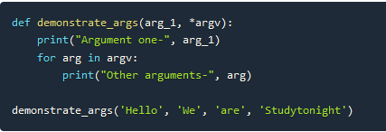
Variable length Parameter
Python allows us to create functions that can take multiple arguments. So, lets create multi-argument functions.
In Python, by adding * and ** (one or two asterisks) to the head of parameter names in the function definition, you can specify an arbitrary number of arguments (variable-length arguments) when calling the function.
By convention, the names *args (arguments) and **kwargs (keyword arguments) are often used, but as long as * and ** are headed, there are no problems with other names. The sample code below uses the names *args and **kwargs.
Example:
def my_sum(*args):
return sum(args)
print(my_sum(1, 2, 3, 4)) # 10
print(my_sum(1, 2, 3, 4, 5, 6, 7, 8)) # 36

Slide 33
Anonymous function
Usually in any programming function declaration should have a valid identifier as name to be invoked, but python supports user defined function to be defined without any name. Such function are called as anonymous function or lambda function.
Syntax:
lambda arguments: expression
Example:
double = lambda x: x * 2
print(double(5))
Lambda functions are used along with built-in functions like filter(), map() etc
Example:
my_list = [1, 5, 4, 6, 8, 11, 3, 12]
new_list = list(filter(lambda x: (x%2 == 0) , my_list))

Slide 34
Object Oriented Programming Paradigm

Slide 35
Introduction
OOP treat data as a critical element in the program development and does not allow it to flow freely around the system.
It ties data more closely to the functions that operate on it, and protects it from accidental modification from outside functions.
OOP allows decomposition of a problem into a number of entities called objects and then build data functions around these objects.
The data of an object can be accessed only by the functions associated with that object.
Functions of one object can access the functions of another objects
Object A
Object B
Data
Data
Communication
Functions
Functions
Object C
Data
Functions

Slide 36
Characteristics
Emphasis is on data rather than procedure.
Programs are divided into objects.
Data structures are designed such that they characterize the objects.
Functions that operate on the data of an object are tied together in the data structure.
Data is hidden and can not be accessed by external functions.
Objects may communicate with each other through functions.
New data and functions can be added easily whenever necessary.
Follows bottom-up approach in program design.

Slide 37
Basic Concepts of Object-Oriented Programming
Objects
Classes
Data Abstraction and Encapsulation
Inheritance
Polymorphism
Dynamic Binding
Message Passing

Slide 38
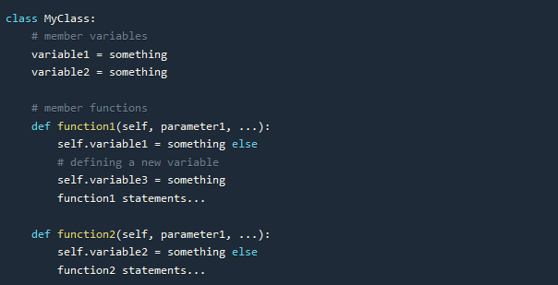
Classes in Python
Defining a class is simple, all you have to do is use the keyword class followed by the name that you want to give your class, and then a colon symbol :. It is standard approach to start the name of class with a capital letter and then follow the camel case style.
The class definition is included, starting from the next line and it should be indented, as shown in the code below. Also, a class can have variables and member functions in it.

Slide 39
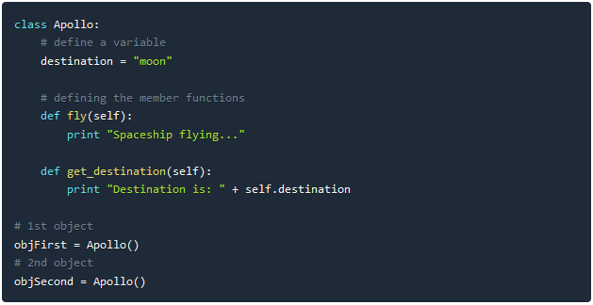
Classes in Python

Slide 40
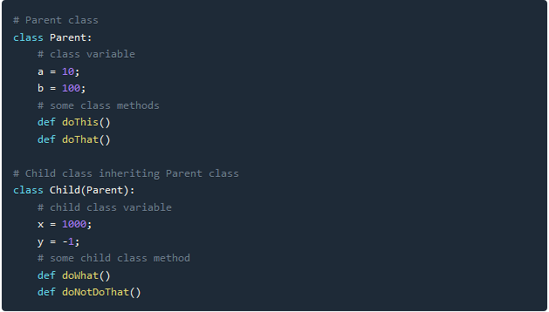
Classes
Note:
We add the self parameter when we define a member function, but do not specify it while calling the function.
When we called get_destination function for objFirst it gave output as Destination is: mars, because we updated the value for the variable destination for the object objFirst
To access a member function or a member variable using an object, we use a dot . symbol.
And to create an object of any class, we have to call the function with same name as of the class.

Slide 41
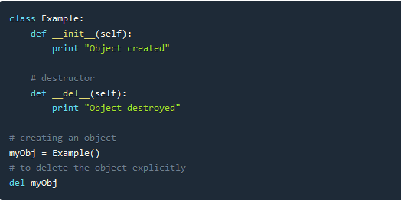
Constructor and Destructor
Note:
Like Destructor is counter-part of a Constructor, function __del__ is the counter-part of function __new__. Because __new__ is the function which creates the object.
__del__ method is called for any object when the reference count for that object becomes zero.
As reference counting is performed, hence it is not necessary that for an object __del__ method will be called if it goes out of scope. The destructor method will only be called when the reference count becomes zero.

Slide 42

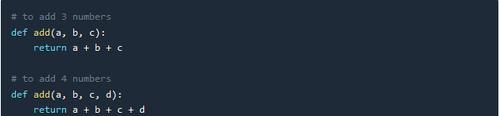
Function Overloading
In OOP, it is possible to make a function act differently using function overloading. All we have to do is, create different functions with same name having different parameters. For example, consider a function add(), which adds all its parameters and returns the result. In python we will define it as,
Python doesn't support method overloading on the basis of different number of parameters in functions.

Slide 43
Function Overloading
def add(a,b):
return a+b
def add(a,b,c):
return a+b+c
print add(4,5)
If you try to run the above piece of code, you get an error stating, “TypeError: add() takes exactly 3 arguments (2 given)”. This is because, Python understands the latest definition of method add() which takes only two arguments. Even though a method add() that takes care of three arguments exists, it didn’t get called. Hence you would be safe to say, overloading methods in Python is not supported.

Slide 44
Inheritance

Slide 45
Method overriding
Method overriding is a concept of object oriented programming that allows us to change the implementation of a function in the child class that is defined in the parent class. It is the ability of a child class to change the implementation of any method which is already provided by one of its parent class(ancestors).
Following conditions must be met for overriding a function:
Inheritance should be there. Function overriding cannot be done within a class. We need to derive a child class from a parent class.
The function that is redefined in the child class should have the same signature as in the parent class i.e. same number of parameters.

Slide 46
Method Overriding
# parent class
class Animal:
# properties
multicellular = True
# Eukaryotic means Cells with Nucleus
eukaryotic = True
# function breath
def breathe(self):
print("I breathe oxygen.")
# function feed
def feed(self):
print("I eat food.")
# child class
class Herbivorous(Animal):
# function feed
def feed(self):
print("I eat only plants. I am vegetarian.")
herbi = Herbivorous()
herbi.feed()
# calling some other function
herbi.breathe()

Slide 47
Functional Programming Paradigm

Slide 48
Introduction
Functional programming is a programming paradigm in which it is tried to bind each and everything in pure mathematical functions. It is a declarative type of programming style that focuses on what to solve rather than how to solve.
Functional programming paradigm is based on lambda calculus.
Instead of statements, functional programming makes use of expressions. Unlike a statement, which is executed to assign variables, evaluation of an expression produces a value.
Functional programming is a declarative paradigm because it relies on expressions and declarations rather than statements. Unlike procedures that depend on a local or global state, value outputs in FP depend only on the arguments passed to the function.
Functional programming consists only of PURE functions.
In functional programming, control flow is expressed by combining function calls, rather than by assigning values to variables.
Example:

Slide 49
Characteristics of Functional Programming
Functional programming method focuses on results, not the process
Emphasis is on what is to be computed
Data is immutable
Functional programming Decompose the problem into 'functions
It is built on the concept of mathematical functions which uses conditional expressions and recursion to do perform the calculation
Functional programming languages are designed on the concept of mathematical functions that use conditional expressions and recursion to perform computation.
Functional programming supports higher-order functions and lazy evaluation features.
Functional programming languages don’t support flow Controls like loop statements and conditional statements like If-Else and Switch Statements. They directly use the functions and functional calls.

Slide 50
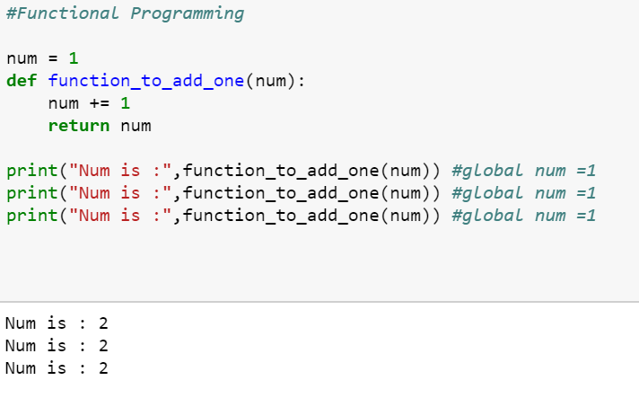
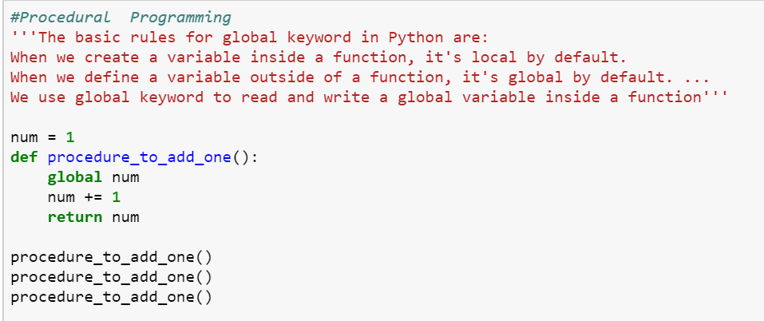
Functional Programming vs Procedure Programming

Slide 51
Mathematical Notation of Functional Programming
Notation:
F(x) = y
x , y -> Arguments or parameters
x -> domain and
y->codomain
Types:
1. Injective if f(a) ≠ f(b)
2. Surjective if f(X)= Y
3. Bijective ( support both)
Functional Rules:
(f+g)(x)=f(x)+g(x)
(f-g)(x)=f(x)-g(x)
(f*g)(x)=f(x)*g(x)
(f/g)(x)=f(x)/g(x)
(gof)(x)=g(f(x))
f f-1=idy

Slide 52
Mathematical Notation of Functional Programming
f(x) = 3x 2 - 2x + 5
def f(x):
return 3 * x ** 2 - 2 * x + 5
>>> f(3)
26
>>> f(0)
5
>>> f(-1)
10
>>> result = f(3) + f(-1)
>>> result #output 36
Function composition is a way of combining functions such that the result of each function is passed as the argument of the next function. Example:
def f(x):
... return 2 * x
>>> def g(x):
... return x + 5
>>> def h(x):
... return x ** 2 - 3
>>> f(3) # 6
>>> g(3) # 8
>>> h(4) # 13
>>> f(g(3)) # 16
>>> g(f(3)) # 11
>>> h(f(g(0))) # 97

Slide 53
Mathematical Notation of Functional Programming
def compose2(f, g):
return lambda x: f(g(x))
>>> def double(x):
... return x * 2
>>> def inc(x):
... return x + 1
...
>>> inc_and_double = compose2(double, inc)
>>> inc_and_double(10)
#output 22

Slide 54
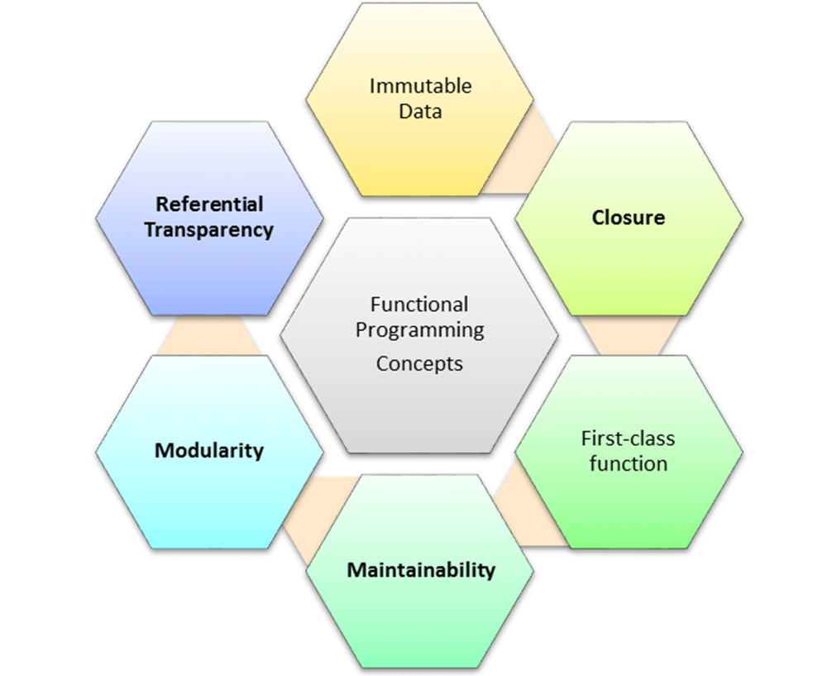
Concepts of FP
Pure functions
Recursion
Referential transparency
Functions are First-Class and can be Higher-Order
Immutability

Slide 55
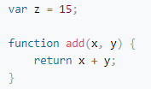
1. Pure functions
Pure functions always return the same results when given the same inputs. Consequently, they have no side effects.
Properties of Pure functions are:
First, they always produce the same output for same arguments irrespective of anything else.
Secondly, they have no side-effects i.e. they do modify any argument or global variables or output something.
A simple example would be a function to receive a collection of numbers and expect it to increment each element of this collection.
We receive the numbers collection, use map with the inc function to increment each number, and return a new list of incremented numbers.
Example:
def inc(x): Note : Function involving Reading files,
return x+1 using global data, random numbers are impure functions
list=[8,3,7,5,2,6]
x=map(inc,list) #print(list)
print(x)
Note: if a function relies on the global variable or class member’s data, then it is not pure. And in such cases, the return value of that function is not entirely dependent on the list of arguments received as input and can also have side effects.
A side effect is a change in the state of an application that is observable outside the called function other than its return value

Slide 56
2. Recursion
In the functional programming paradigm, there is no for and while loops. Instead, functional programming languages rely on recursion for iteration. Recursion is implemented using recursive functions, which repetitively call themselves until the base case is reached.

Slide 57

Immutability
In functional programming you cannot modify a variable after it has been initialized. You can create new variables and this helps to maintain state throughout the runtime of a program.
In imperative programming, this means “take the current value of x, add 1 and put the result back into x.” In functional programming, however, x = x + 1 is illegal. That’s because there are technically no variables in functional programming.
Using immutable data structures, you can make single or multi-valued changes by copying the variables and calculating new values,
Since FP doesn’t depend on shared states, all data in functional code must be immutable, or incapable of changing

Slide 58
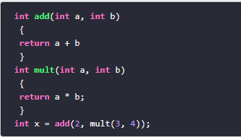
Referential transparency
An expression is said to be referentially transparent if it can be replaced with its corresponding value without changing the program's behaviour. As a result, evaluating a referentially transparent function gives the same value for fixed arguments. If a function consistently yields the same result for the same input, it is referentially transparent.
Functional programs don’t have any assignment statements. For storing additional values in a program developed using functional programming, new variables must be defined. State of a variable in such a program is constant at any moment in time
pure function + immutable data = referential transparency
Let’s implement a square function:
This (pure) function will always have the same output, given the same input.
Passing “2” as a parameter of the square function will always returns 4. So now we can replace the (square 2) with 4.

Slide 59
LAMBDA FUNCTION
A lambda function is a small anonymous function.
A lambda function can take any number of arguments, but can only have one expression.
Syntax:
lambda arguments : expression
x = lambda a : a + 10 print(x(5))
x = lambda a, b : a * b print(x(5, 6))

Slide 60
Functions are First-Class and can be Higher-Order
A programming language is said to have First-class functions when functions in that language are treated like any other variable. For example, in such a language, a function can be passed as an argument to other functions, can be returned by another function and can be assigned as a value to a variable.
Higher-order functions are functions that take at least one first-class function as a parameter
Examples:
name_lengths = map(len, ["Bob", "Rob", "Bobby"])
Higher Order functions are map, reduce, filter
The reduce() method reduces the array to a single value
Functional style of getting a sum of a list:
new_lst = [1, 2, 3, 4]
def sum_list(lst):
if len(lst) == 1:
return lst[0]
else:
return lst[0] + sum_list(lst[1:])
print(sum_list(new_lst))
# or the pure functional way in python using higher order function
import functools
new_lst = [1, 2, 3, 4]
print(functools.reduce(lambda x, y: x + y, new_lst))

Slide 61
Functions are First-Class and can be Higher-Order
Map
map() can run the function on each item and insert the return values into the new collection.
The map() method creates a new array with the results of calling a function for every array element. The map() method calls the provided function once for each element in an array, in order.
map(function, iterables)
Example:
import functools
def myfunc(a, b):
return a + b
x = map(myfunc, ('apple', 'banana', 'cherry'), ('orange', 'lemon', 'pineapple'))
print(x)
print(list(x))
reduce()
reduce() is another higher order function for performing iterations. It takes functions and collections of items, and then it returns the value of combining the items
Example: sum = reduce(lambda a, x: a + x, [0, 1, 2, 3, 4])
print sum // 10

Slide 62
Functions are First-Class and can be Higher-Order ..cont
filter()
filter function expects a true or false value to determine if the element should or should not be included in the result collection. Basically, if the call-back expression is true, the filter function will include the element in the result collection. Otherwise, it will not.
filter() Parameters
filter() method takes two parameters:
function - function that tests if elements of an iterable return true or false
If None, the function defaults to Identity function - which returns false if any elements are false
iterable - iterable which is to be filtered, could be sets, lists, tuples, or containers of any iterators

Slide 63
FILTER-EXAMPLE
# list of letters
letters = ['a', 'b', 'd', 'e', 'i', 'j', 'o']
# function that filters vowels
def filter_vowels(letter):
vowels = ['a', 'e', 'i', 'o', 'u']
if(letter in vowels):
return True
else:

Slide 64
FILTER-EXAMPLE
return False
filtered_vowels = filter(filter_vowels, letters)
print('The filtered vowels are:')
for vowel in filtered_vowels:
print(vowel)

Slide 65
Functional Programming – Non Strict Evaluation
In programming language theory, lazy evaluation, or call-by-need[1] is an evaluation strategy which delays the evaluation of an expression until its value is needed (non-strict evaluation) and which also avoids repeated evaluations
Allows Functions having variables that have not yet been computed
In Python, the logical expression operators and, or, and if-then-else are all non-strict. We sometimes call them short-circuit operators because they don't need to evaluate all arguments to determine the resulting value.
The following command snippet shows the and operator's non-strict feature:
>>> 0 and print("right")
0
>>> True and print("right")
Right
When we execute the preceding command snippet, the left-hand side of the and operator is equivalent to False; the right-hand side is not evaluated. When the left-hand side is equivalent to True, the right-hand side is evaluated

Slide 66
Functional Programming – lambda calculus
Lambda expressions in Python and other programming languages have their roots in lambda calculus. Lambda calculus can encode any computation. Functional languages get their origin in mathematical logic and lambda calculus
In Python, we use the lambda keyword to declare an anonymous function, which is why we refer to them as "lambda functions". An anonymous function refers to a function declared with no name.
when you want to pass a function as an argument to higher-order functions, that is, functions that take other functions as their arguments
Characteristics of Python lambda functions:
A lambda function can take any number of arguments, but they contain only a single expression. An expression is a piece of code executed by the lambda function, which may or may not return any value.
Lambda functions can be used to return function objects.
Syntactically, lambda functions are restricted to only a single expression.
Syntax:
lambda argument(s): expression
Example:
remainder = lambda num: num % 2 [(lambda x: x*x)(x) for x in [2,6,9,3,6,4,8]]
print(remainder(5))

Slide 67
Functional Programming – Closure
Basically, the method of binding data to a function without actually passing them as parameters is called closure. It is a function object that remembers values in enclosing scopes even if they are not present in memory.
Example:.
def counter(start=0, step=1):
x = [start]
def _inc():
x[0] += step
return x[0]
return _inc
c1 = counter()
c2 = counter(100, -10)
c1()
//1
c2()
90

Slide 68
Functional Programming in Python
Functional Programming is a popular programming paradigm closely linked to computer science's mathematical foundations. While there is no strict definition of what constitutes a functional language, we consider them to be languages that use functions to transform data.
Python is not a functional programming language but it does incorporate some of its concepts alongside other programming paradigms. With Python, it's easy to write code in a functional style, which may provide the best solution for the task at hand.

Slide 69
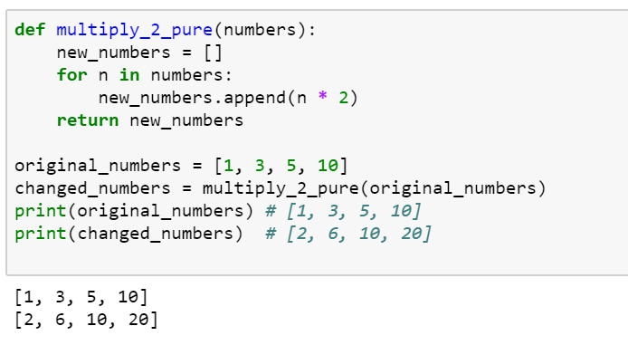
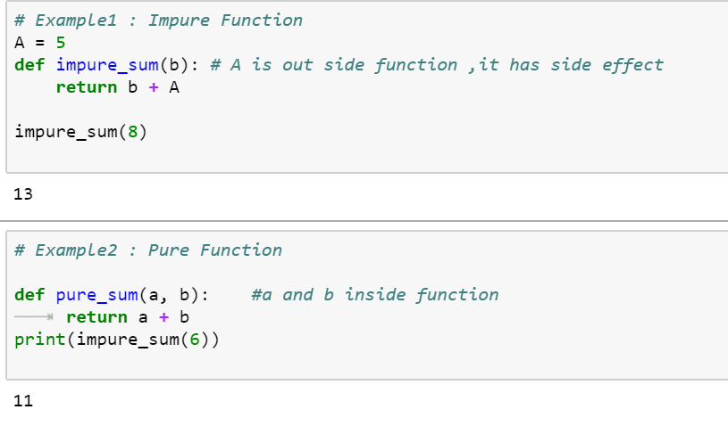
Pure Functions in Python
If a function uses an object from a higher scope or random numbers, communicates with files and so on, it might be impure

Slide 70
Built-in Higher Order Functions
Map
The map function allows us to apply a function to every element in an iterable object
Filter
The filter function tests every element in an iterable object with a function that returns either True or False, only keeping those which evaluates to True.
Combining map and filter
As each function returns an iterator, and they both accept iterable objects, we can use them together for some really expressive data manipulations!
List Comprehensions
A popular Python feature that appears prominently in Functional Programming Languages is list comprehensions. Like the map and filter functions, list comprehensions allow us to modify data in a concise, expressive way.

Slide 71
Anonymous Function
In Python, anonymous function is a function that is defined without a name.
While normal functions are defined using the def keyword, in Python anonymous functions are defined using the lambda keyword.
Characteristics of Python lambda functions:
A lambda function can take any number of arguments, but they contain only a single expression. An expression is a piece of code executed by the lambda function, which may or may not return any value.
Lambda functions can be used to return function objects.
Syntactically, lambda functions are restricted to only a single expression.
Syntax of Lambda Function in python
lambda arguments: expression
Example:
double = lambda x: x * 2 product = lambda x, y : x * y
print(double(5)) print(product(2, 3))
# Output: 10
Note: you want to pass a function as an argument to higher-order functions, that is, functions that take other functions as their arguments.

Slide 72
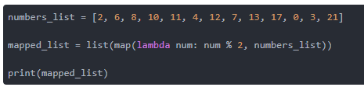
map() Function
Example Map with lambda
tup= (5, 7, 22, 97, 54, 62, 77, 23, 73, 61)
newtuple = tuple(map(lambda x: x+3 , tup))
print(newtuple)
//with multiple iterables
list_a = [1, 2, 3]
list_b = [10, 20, 30]
map(lambda x, y: x + y, list_a, list_b)
Example with Map
from math import sqrt
map(sqrt, [1, 4, 9, 16])
[1.0, 2.0, 3.0, 4.0]
map(str.lower, ['A', 'b', 'C'])
['a', 'b', 'c']
#splitting the input and convert to int using map
print(list(map(int, input.split(‘ ‘)))

Slide 73
map() Function
map() function is a type of higher-order. As mentioned earlier, this function takes another function as a parameter along with a sequence of iterables and returns an output after applying the function to each iterable present in the sequence.
Syntax:
map(function, iterables)
Example without Map
my_pets = ['alfred', 'tabitha', 'william', 'arla']
uppered_pets = []
for pet in my_pets:
pet_=pet.upper()
uppered_pets.append(pet_)
print(uppered_pets)
Example with Map
my_pets = ['alfred', 'tabitha', 'william', 'arla']
uppered_pets=list(map(str.upper,my_pets)) print(uppered_pets)
//map with multiple list as input
circle_areas = [3.56773, 5.57668, 4.00914, 56.24241, 9.01344, 32.00013]
result = list(map(round, circle_areas, range(1,7)))
print(result)

Slide 74
filter() Function
filter extracts each element in the sequence for which the function returns True.
filter(), first of all, requires the function to return boolean values (true or false) and then passes each element in the iterable through the function, "filtering" away those that are false
Syntax:
filter(func, iterable)
The following points are to be noted regarding filter():
Unlike map(), only one iterable is required.
The func argument is required to return a boolean type. If it doesn't, filter simply returns the iterable passed to it. Also, as only one iterable is required, it's implicit that func must only take one argument.
filter passes each element in the iterable through func and returns only the ones that evaluate to true. I mean, it's right there in the name -- a "filter".
Example:
def isOdd(x): return x % 2 == 1
filter(isOdd, [1, 2, 3, 4])
# output ---> [1, 3]

Slide 75
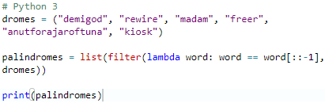
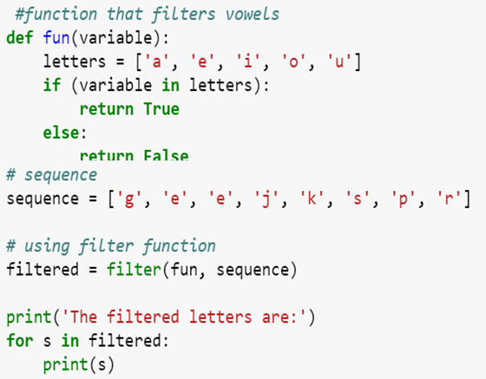
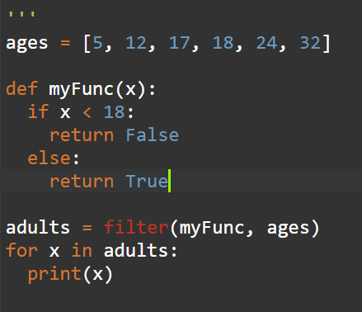
filter() Function
Example:
# Python 3
scores = [66, 90, 68, 59, 76, 60, 88, 74, 81, 65]
def is_A_student(score):
return score > 75
over_75 = list(filter(is_A_student, scores))
print(over_75)

Slide 76
reduce() Function
reduce, combines the elements of the sequence together, using a binary function. In addition to the function and the list, it also takes an initial value that initializes the reduction, and that ends up being the return value if the list is empty.
The “reduce” function will transform a given list into a single value by applying a given function continuously to all the elements. It basically keeps operating on pairs of elements until there are no more elements left.
reduce applies a function of two arguments cumulatively to the elements of an iterable, optionally starting with an initial argument
Syntax:
reduce(func, iterable[, initial])
Example:
reduce(lambda s,x: s+str(x), [1, 2, 3, 4], '')
#output '1234‘
my_list = [3,8,4,9,5]
reduce(lambda a, b: a * b, my_list)
#output 4320 ( 3*8*4*9*5)
from functools import reduce
y = filter(lambda x: (x>=3), (1,2,3,4))
print(list(y))
reduce(lambda a,b: a+b,[23,21,45,98])
nums = [92, 27, 63, 43, 88, 8, 38, 91, 47, 74, 18, 16,
29, 21, 60, 27, 62, 59, 86, 56]
sum = reduce(lambda x, y : x + y, nums) / len(nums)

Slide 77
map(), filter() and reduce() Function
Using filter() within map():
c = map(lambda x:x+x,filter(lambda x: (x>=3), (1,2,3,4)))
print(list(c))
Using map() within filter():
c = filter(lambda x: (x>=3),map(lambda x:x+x, (1,2,3,4))) #lambda x: (x>=3)
print(list(c))
Using map() and filter() within reduce():
d = reduce(lambda x,y: x+y,map(lambda x:x+x,filter(lambda x: (x>=3), (1,2,3,4))))
print(d)

Slide 78
map(), filter() and reduce() Function
from functools import reduce
# Use map to print the square of each numbers rounded# to two decimal places
my_floats = [4.35, 6.09, 3.25, 9.77, 2.16, 8.88, 4.59]
# Use filter to print only the names that are less than or equal to seven letters
my_names = ["olumide", "akinremi", "josiah", "temidayo", "omoseun"]
# Use reduce to print the product of these numbers
my_numbers = [4, 6, 9, 23, 5]
map_result = list(map(lambda x: round(x ** 2, 3), my_floats))
filter_result = list(filter(lambda name: len(name) <= 7, my_names))
reduce_result = reduce(lambda num1, num2: num1 * num2, my_numbers)
print(map_result)
print(filter_result)
print(reduce_result)

Slide 79
Function vs Procedure
S.No | Functional Paradigms | Procedural Paradigm
1 | Treats computation as the evaluation of mathematical functions avoiding state and mutable data | Derived from structured programming, based on the concept of modular programming or the procedure call
2 | Main traits are Lambda alculus, compositionality, formula, recursion, referential transparency | Main traits are Local variables, sequence, selection, iteration, and modularization
3 | Functional programming focuses on expressions | Procedural programming focuses on statements
4 | Often recursive. Always returns the same output for a given input. | The output of a routine does not always have a direct correlation with the input.
5 | Order of evaluation is usually undefined. | Everything is done in a specific order.
6 | Must be stateless. i.e. No operation can have side effects. | Execution of a routine may have side effects.
7 | Good fit for parallel execution, Tends to emphasize a divide and conquer approach. | Tends to emphasize implementing solutions in a linear fashion.

Slide 80
Function vs Object Oriented
S.No | Functional Paradigms | Object Oriented Paradigm
1 | FP uses Immutable data. | OOP uses Mutable data.
2 | Follows Declarative Programming based Model. | Follows Imperative Programming Model.
3 | What it focuses is on: "What you are doing. in the programme." | What it focuses is on "How you are doing your programming."
4 | Supports Parallel Programming. | No supports for Parallel Programming.
5 | Its functions have no-side effects. | Method can produce many side effects.
6 | Flow Control is performed using function calls & function calls with recursion. | Flow control process is conducted using loops and conditional statements.
7 | Execution order of statements is not very important. | Execution order of statements is important.
8 | Supports both "Abstraction over Data" and "Abstraction over Behavior." | Supports only "Abstraction over Data".

